Slide 1

6
5
4
3
2
1
FACULTY : MISS NEELUM MALIK

Slide 2





INTRODUCTION ABOUT WEBSITE:
6
ONLINE SHOPPING
Online shopping is not limited to products alone; it also encompasses various services, including booking travel accommodations, ordering food delivery, and hiring professionals for various tasks. The digital marketplace continues to expand, offering innovative and diverse options for consumers.
5
4
TEDDY BEARS
HAND BAGS
WATCHES
3
2
BEAUTY PRODUCTS
PERFUMES
1

Slide 3

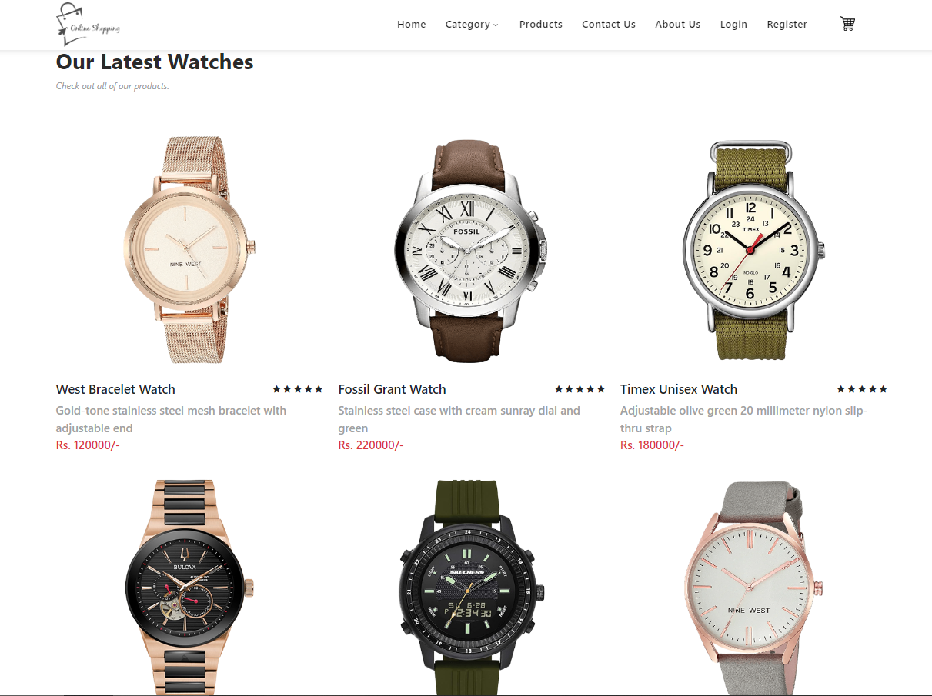
php
6
KASHAN KASHEEF
Batch: 2211C2
5
FINALIZATION
CRUD OPRATIONS
4
DEVELOPMENT
3
2
1

Slide 4
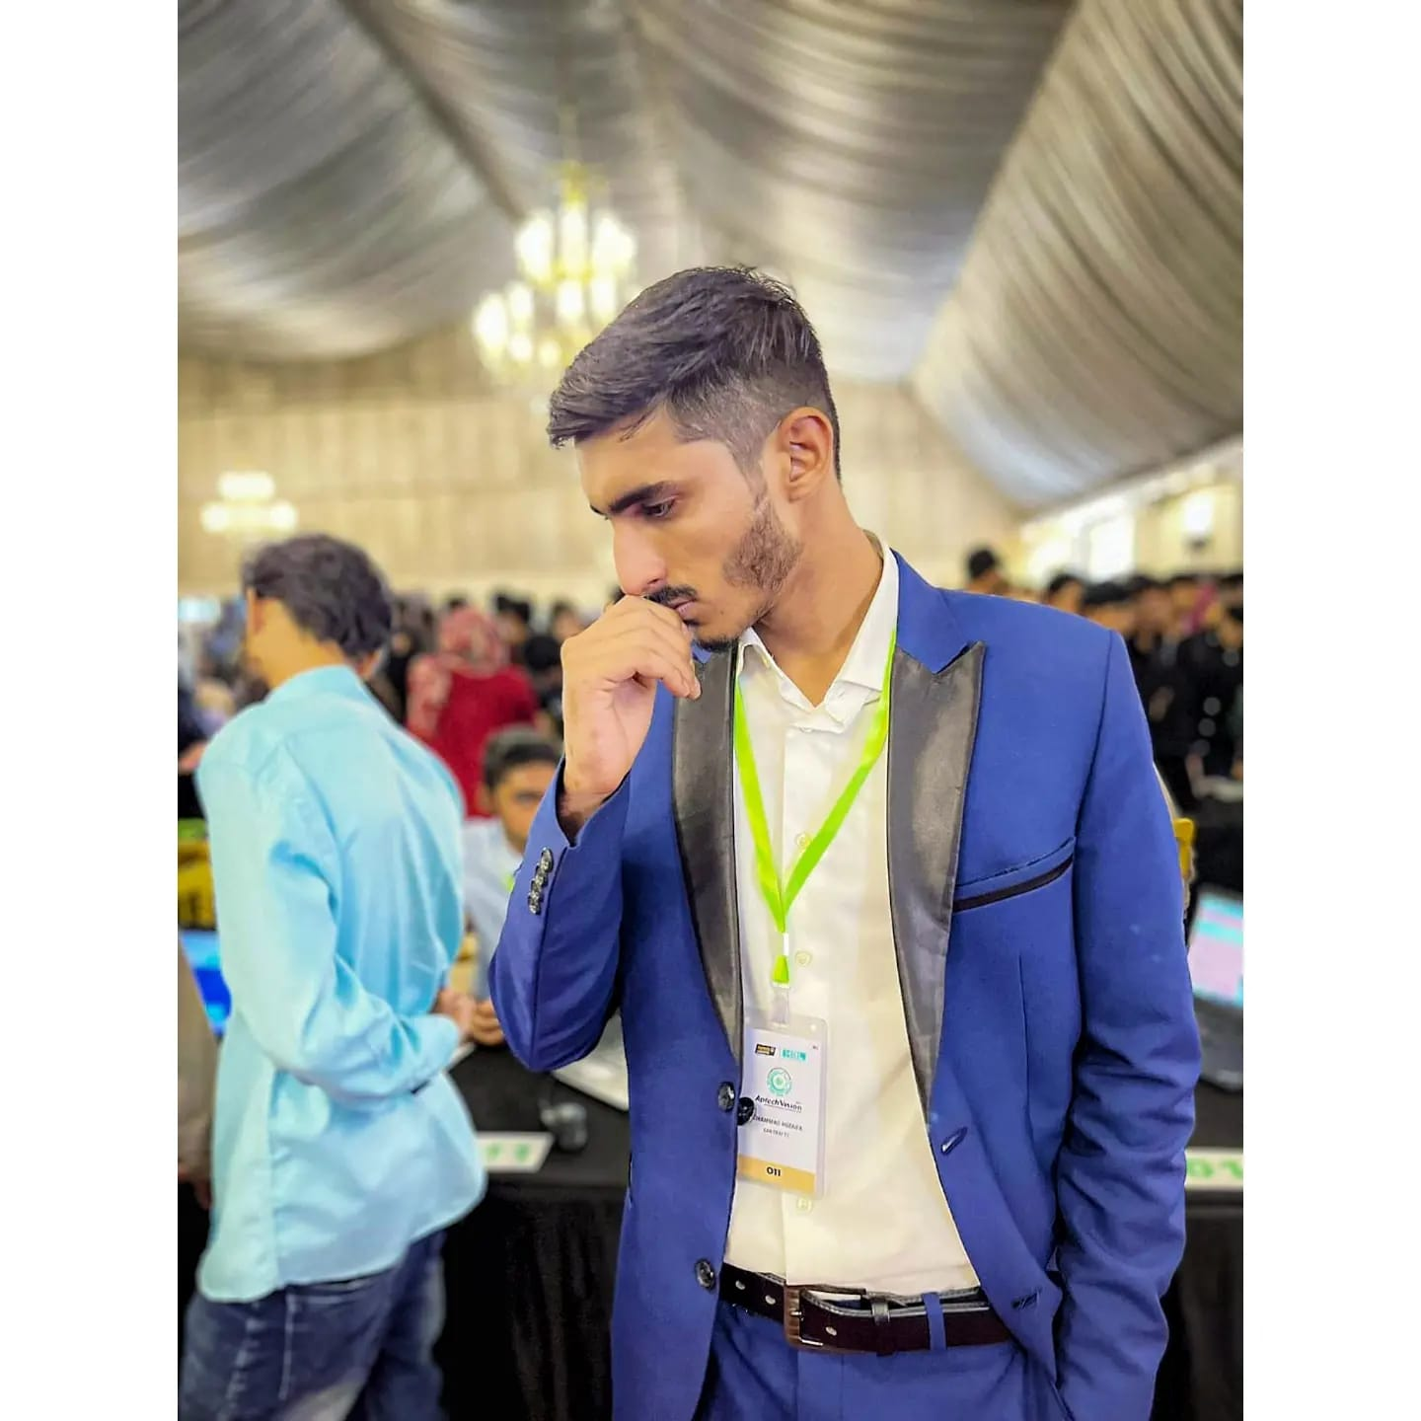
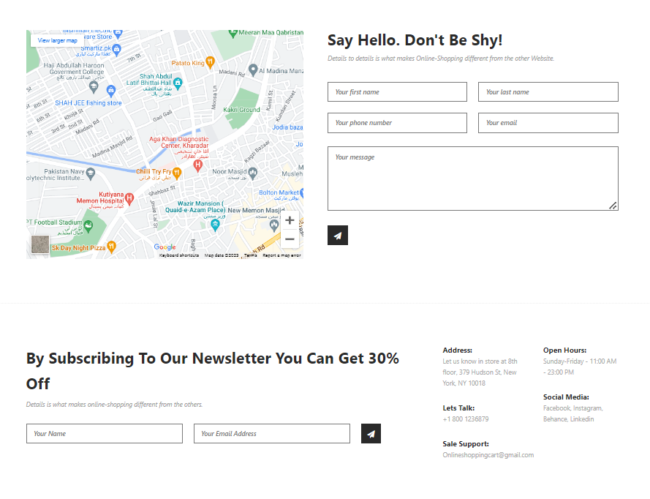
FINALIZATION
MOHAMMAD HUZAIFA
6
Batch: 2211C2
5
CRUD OPRATIONS
FINALIZATION
DEVELOPMENT
4
3
2
1

Slide 5

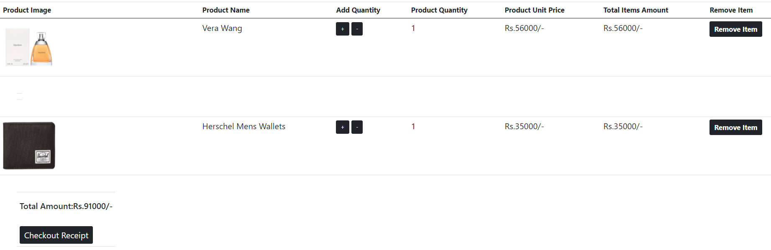
FINALIZATION
JAMILA MUGHAL
6
Batch: 2211C2
5
FINALIZATION
DATA BASE
DEVELOPMENT
4
3
2
1

Slide 6

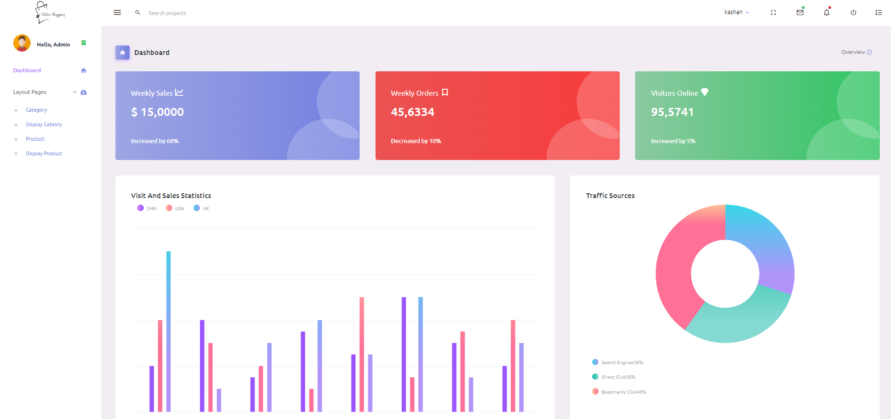
HUZAIFA IMRAN
6
Batch: 2211C2
FINALIZATION
DOCUMENTATION
DEVELOPMENT
5
4
3
2
1

Slide 7

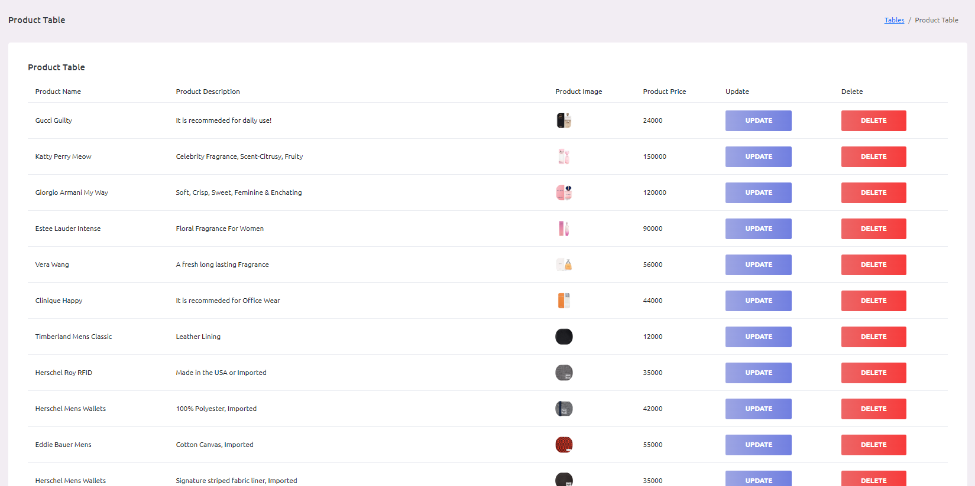
SALMAN KHAN
6
Batch: 2211C2
5
4
FINALIZATION
3
DOCUMENTATION
2
DATA BASE
1

Slide 8

THANK YOU
HOPE YOU LIKE OUR WEBSITE

